Slide 1
Finding stress factors and solving them through auto exercise recommendation
-Global AI Research Program-
-Suwon Jang, Hyein Jo, Yewon Park-
Notes:
Hello, our name is Suwon Jang, Hyen Jo, Yewon Park and we will taking about 'Finding stress factors and solving through auto exercise recommendation'.

Slide 2
What is stress?
Abstract
Stress
—noun—
Sense relating to adversity, strain, or exertion.
Notes:
We often hear that stress is the factor of all diseases. mild ones like cold or influenza, and sedious ones like cancer.
That makes us question, What is stress? Do we have stress?

Slide 3
Abstract
What is stress?
Stress
—noun—
Sense relating to adversity, strain, or exertion.
Stress - Quick Search Results | Oxford English Dictionary. https://www.oed.com/search/dictionary/?scope=Entries&q=stress&tl=true. Accessed 9 Jan. 2025.
There are inherent limitations to using self-report measures.
First, consciously perceived and self-reported ratings of distress and stress using standard scales explain a limited amount of variance in physiological stress reactivity and biological outcomes. This poses a problem given that the mechanistic pathway linking psychological stress to worse health is hypothesized to be through dysregulated stress reactivity profiles. The lack of association between self-reported ratings of stress and physiological indicators of stress arousal is likely due to many factors.
First, events are not exclusively experienced through conscious perception as assumed in basic stress models. Emotional responses are constructed through iterative processes that incorporate the social world (this point is further described below).
Second, subjective reports of being “stressed” are potentially limited
by individuals’ unwillingness or inability to report their veridical stress state. Unwillingness might be due to not wanting to appear weak or fragile. Inability to report might be due to lack of conscious perception. Additionally, there is a relative comparison process where one’s subjective understanding of “stress” is calibrated relative to other adverse aspects of their lives as well as to the lives of those in their community. Lastly, if an environment is physically dangerous, or basic resources are especially scarce, a subjective response to “how stressful is your life”might be met with less affirmation given that the lay understanding of stress does not necessarily capture physical danger or basic survival.
Notes:
Stress is a sense relating to adversity, strain or exertion, as defined by ~~ Oxford english dictionary.
Then, Are you stressed? Are you sure you are stressed? people nowadays all look stressed, making the awareness of stress lower. That means- We are unaware whether we are seriously stressed, or just stressed lightly, not effecting our health.

Slide 4
Abstract
Are you stressed?
There are inherent limitations to using self-report measures.
First, consciously perceived and self-reported ratings of distress and stress using standard scales explain a limited amount of variance in physiological stress reactivity and biological outcomes. This poses a problem given that the mechanistic pathway linking psychological stress to worse health is hypothesized to be through dysregulated stress reactivity profiles. The lack of association between self-reported ratings of stress and physiological indicators of stress arousal is likely due to many factors.
First, events are not exclusively experienced through conscious perception as assumed in basic stress models. Emotional responses are constructed through iterative processes that incorporate the social world (this point is further described below).
Second, subjective reports of being “stressed” are potentially limited
by individuals’ unwillingness or inability to report their veridical stress state. Unwillingness might be due to not wanting to appear weak or fragile. Inability to report might be due to lack of conscious perception. Additionally, there is a relative comparison process where one’s subjective understanding of “stress” is calibrated relative to other adverse aspects of their lives as well as to the lives of those in their community. Lastly, if an environment is physically dangerous, or basic resources are especially scarce, a subjective response to “how stressful is your life”might be met with less affirmation given that the lay understanding of stress does not necessarily capture physical danger or basic survival.
More than a feeling: A unified view of stress measurement for
population science
Elissa S. Epel, Alexandra D. Crosswell, Stefanie E. Mayer, Aric A. Prather, George M. Slavich, Eli Puterman, Wendy Berry Mendes
https://doi.org/10.1016/j.yfrne.2018.03.001.
Epel, Elissa S., et al. “More than a Feeling: A Unified View of Stress Measurement for Population Science.” Frontiers in Neuroendocrinology, vol. 49, Apr. 2018, pp. 146–69. PubMed Central, https://doi.org/10.1016/j.yfrne.2018.03.001.
Notes:
We found some papers indicating that we are unaware of stress.
The first one tells that “YELLOW”

Slide 5
Abstract
Are you stressed?
There are inherent limitations to using self-report measures.
First, consciously perceived and self-reported ratings of distress and stress using standard scales explain a limited amount of variance in physiological stress reactivity and biological outcomes. This poses a problem given that the mechanistic pathway linking psychological stress to worse health is hypothesized to be through dysregulated stress reactivity profiles. The lack of association between self-reported ratings of stress and physiological indicators of stress arousal is likely due to many factors.
First, events are not exclusively experienced through conscious perception as assumed in basic stress models. Emotional responses are constructed through iterative processes that incorporate the social world (this point is further described below).
Second, subjective reports of being “stressed” are potentially limited
by individuals’ unwillingness or inability to report their veridical stress state. Unwillingness might be due to not wanting to appear weak or fragile. Inability to report might be due to lack of conscious perception. Additionally, there is a relative comparison process where one’s subjective understanding of “stress” is calibrated relative to other adverse aspects of their lives as well as to the lives of those in their community. Lastly, if an environment is physically dangerous, or basic resources are especially scarce, a subjective response to “how stressful is your life”might be met with less affirmation given that the lay understanding of stress does not necessarily capture physical danger or basic survival.
More than a feeling: A unified view of stress measurement for
population science
Elissa S. Epel, Alexandra D. Crosswell, Stefanie E. Mayer, Aric A. Prather, George M. Slavich, Eli Puterman, Wendy Berry Mendes
https://doi.org/10.1016/j.yfrne.2018.03.001.
Epel, Elissa S., et al. “More than a Feeling: A Unified View of Stress Measurement for Population Science.” Frontiers in Neuroendocrinology, vol. 49, Apr. 2018, pp. 146–69. PubMed Central, https://doi.org/10.1016/j.yfrne.2018.03.001.
concerns the explanation of the occurrence of the type of stress responses that can cause disease,
namely prolonged or chronic stress-related physiological activity. This is—in our opinion—the basic
problem of the science of stress and disease. Conventional stress theory has been unable to fully
explain this critical mediator of the stress-disease relationship, largely because these theories have
remained focused on stressors, that is, actual threats in the environment. However, stressors are not
necessary for the stress response to be released: a lack of information about safety is sufficient. With no
such information, generalized unsafety is assumed by the brain, and the default stress response is
disinhibited. The question should not be “what causes prolonged activity?” but “what stops it”.
Accounting for the role of safety and the default quality of the stress response requires a considerable
modification and reformulation of the conventional stress theory. The newly proposed theory, GUTS,
can explain the presence of prolonged stress-related physiological activity in a range of situations
without stressors.
A second important consequence of the notion of the stress response being a default response is that it is largely unconscious, because of its phylogenetic age, its pervasiveness across the animal
kingdom, its often continuous nature, and the fact that ontogenetically it is largely determined during prenatal and early life stages to which we have no conscious access.
Finally, a third consequence consists of the astonishing array of situations or conditions
(called domains in GUTS terminology) in which prolonged stress response occur without any
stressors, assumedly because these domains are compromised in terms of unsafety. By focusing on
stressors stress science seems to have missed a lot. For example, loneliness, prenatal maternal stress,
post-natal adversity, and chronic anxiety (including anxiety disorders) are associated with prolonged
physiological activity and are now being recognized as belonging to the strongest psychological
predictors of organic disease [ 19 –37 ]. Purportedly, the reason that these domains were largely missed
by stress science is that they cannot easily be understood in terms of stressors or at least no concurrent
stressors. Interestingly, some theorists even oppose including anxiety as a stress phenomenon, as being
too “global” [38], while in neuroscience, stress and anxiety are commonly treated as the same subject,
because of their shared neurobiology (e.g., [5–9,14,39])
Notes:
The stress is also hidden unconsciously, by “YELLOW"

Slide 6
Abstract
Are you stressed?
There are inherent limitations to using self-report measures.
First, consciously perceived and self-reported ratings of distress and stress using standard scales explain a limited amount of variance in physiological stress reactivity and biological outcomes. This poses a problem given that the mechanistic pathway linking psychological stress to worse health is hypothesized to be through dysregulated stress reactivity profiles. The lack of association between self-reported ratings of stress and physiological indicators of stress arousal is likely due to many factors.
First, events are not exclusively experienced through conscious perception as assumed in basic stress models. Emotional responses are constructed through iterative processes that incorporate the social world (this point is further described below).
Second, subjective reports of being “stressed” are potentially limited
by individuals’ unwillingness or inability to report their veridical stress state. Unwillingness might be due to not wanting to appear weak or fragile. Inability to report might be due to lack of conscious perception. Additionally, there is a relative comparison process where one’s subjective understanding of “stress” is calibrated relative to other adverse aspects of their lives as well as to the lives of those in their community. Lastly, if an environment is physically dangerous, or basic resources are especially scarce, a subjective response to “how stressful is your life”might be met with less affirmation given that the lay understanding of stress does not necessarily capture physical danger or basic survival.
concerns the explanation of the occurrence of the type of stress responses that can cause disease,
namely prolonged or chronic stress-related physiological activity. This is—in our opinion—the basic
problem of the science of stress and disease. Conventional stress theory has been unable to fully
explain this critical mediator of the stress-disease relationship, largely because these theories have
remained focused on stressors, that is, actual threats in the environment. However, stressors are not
necessary for the stress response to be released: a lack of information about safety is sufficient. With no
such information, generalized unsafety is assumed by the brain, and the default stress response is
disinhibited. The question should not be “what causes prolonged activity?” but “what stops it”.
Accounting for the role of safety and the default quality of the stress response requires a considerable
modification and reformulation of the conventional stress theory. The newly proposed theory, GUTS,
can explain the presence of prolonged stress-related physiological activity in a range of situations
without stressors.
A second important consequence of the notion of the stress response being a default response is that it is largely unconscious, because of its phylogenetic age, its pervasiveness across the animal
kingdom, its often continuous nature, and the fact that ontogenetically it is largely determined during prenatal and early life stages to which we have no conscious access.
Finally, a third consequence consists of the astonishing array of situations or conditions
(called domains in GUTS terminology) in which prolonged stress response occur without any
stressors, assumedly because these domains are compromised in terms of unsafety. By focusing on
stressors stress science seems to have missed a lot. For example, loneliness, prenatal maternal stress,
post-natal adversity, and chronic anxiety (including anxiety disorders) are associated with prolonged
physiological activity and are now being recognized as belonging to the strongest psychological
predictors of organic disease [ 19 –37 ]. Purportedly, the reason that these domains were largely missed
by stress science is that they cannot easily be understood in terms of stressors or at least no concurrent
stressors. Interestingly, some theorists even oppose including anxiety as a stress phenomenon, as being
too “global” [38], while in neuroscience, stress and anxiety are commonly treated as the same subject,
because of their shared neurobiology (e.g., [5–9,14,39])
Generalized Unsafety Theory of Stress: Unsafe Environments and Conditions, and the Default Stress Response
Brosschot JF, Verkuil B, Thayer JF.
https://doi.org/10.3390/ijerph15030464
Epel, Elissa S., et al. “More than a Feeling: A Unified View of Stress Measurement for Population Science.” Frontiers in Neuroendocrinology, vol. 49, Apr. 2018, pp. 146–69. PubMed Central, https://doi.org/10.1016/j.yfrne.2018.03.001.
Notes:
the second paper tells that stress is largely unconscious, following to the history of the humans.

Slide 7

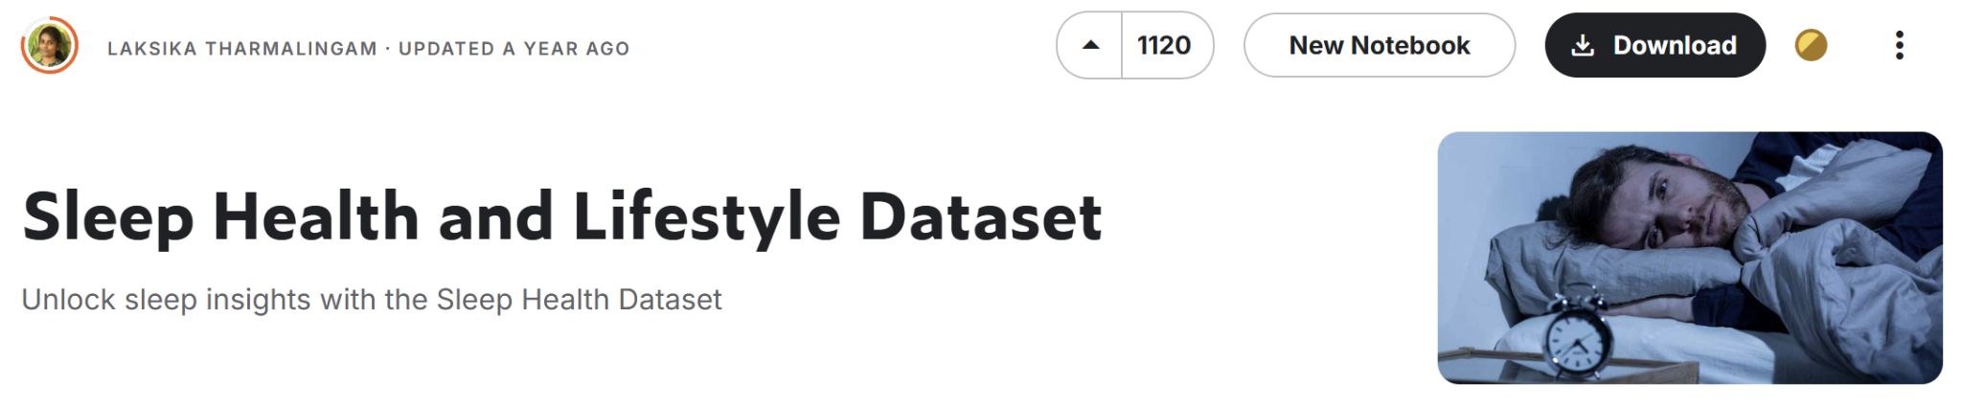

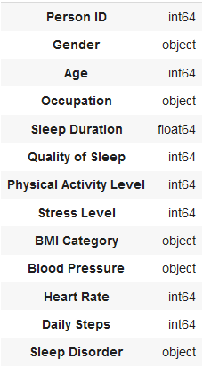
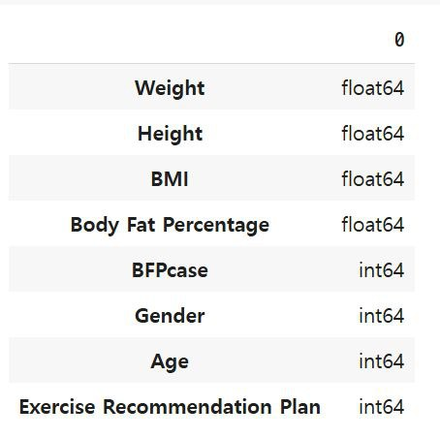
Abstract
Datasets
https://www.kaggle.com
Method 1.
Sleep Health and Lifestyle Dataset
Method 2.
Exercise Recommendation Plan Dataset
Notes:
We chose the following dataset to predict stress levels with individual health information and to provide an appropriate exercise plan to manage stress.
These two datasets are smiliar.
One is finding the relation of daily life datas and stress, and the other is the relation of body informations and recommended exercise plan.

Slide 8
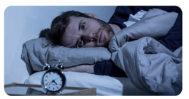
Method 1.
Sleep Health and Lifestyle Dataset
Purpose: Acknowledging the relation with stress and factors.
Progress:
EDA
Preprocessing
Modeling
Optimizing
Heatmap
Data drop
One Hot Encode
Logistic
Regression
MLP
Regularization
Notes:
The first dataset is the dataset of sleep health and lifestyle dataset, for the purpose of “PURPOSE”
The progress was held by the following

Slide 9
Abstract
Datasets
Method 1.
Method 2.
Sleep Health and Lifestyle Dataset
Exercise Recommendation Plan Dataset
EDA
Heatmap
Preprocessing
Data drop
One Hot Encode
Modeling
Logistic
Regression
Optimizing
MSE
Notes:
The column of the one dataset contains _____ and so on.
And the other contains _____ and so on.

Slide 10
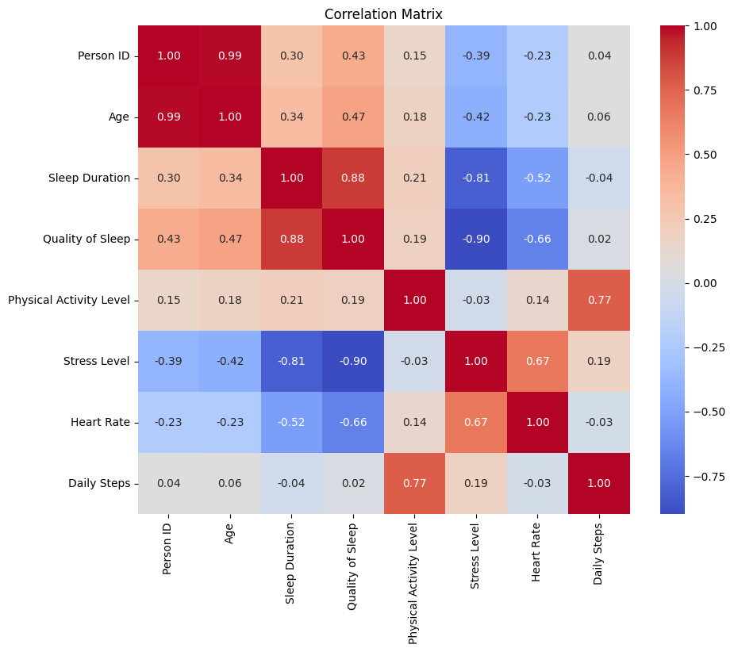
Method 1.
Finding the correlations
01
Quality of Sleep
Sleep Duration
-0.90
-0.81
02
Age
-0.42
03
Heart Rate
Daily Steps
0.67
0.19
Notes:
to find the relation with stress, i firstly made the heatmap. As you can see, the horizontal- highlighted points are very vivid, indicating the big correlation with stress and other factors. the right side show the correaltation rate. There was many negative relations

Slide 11
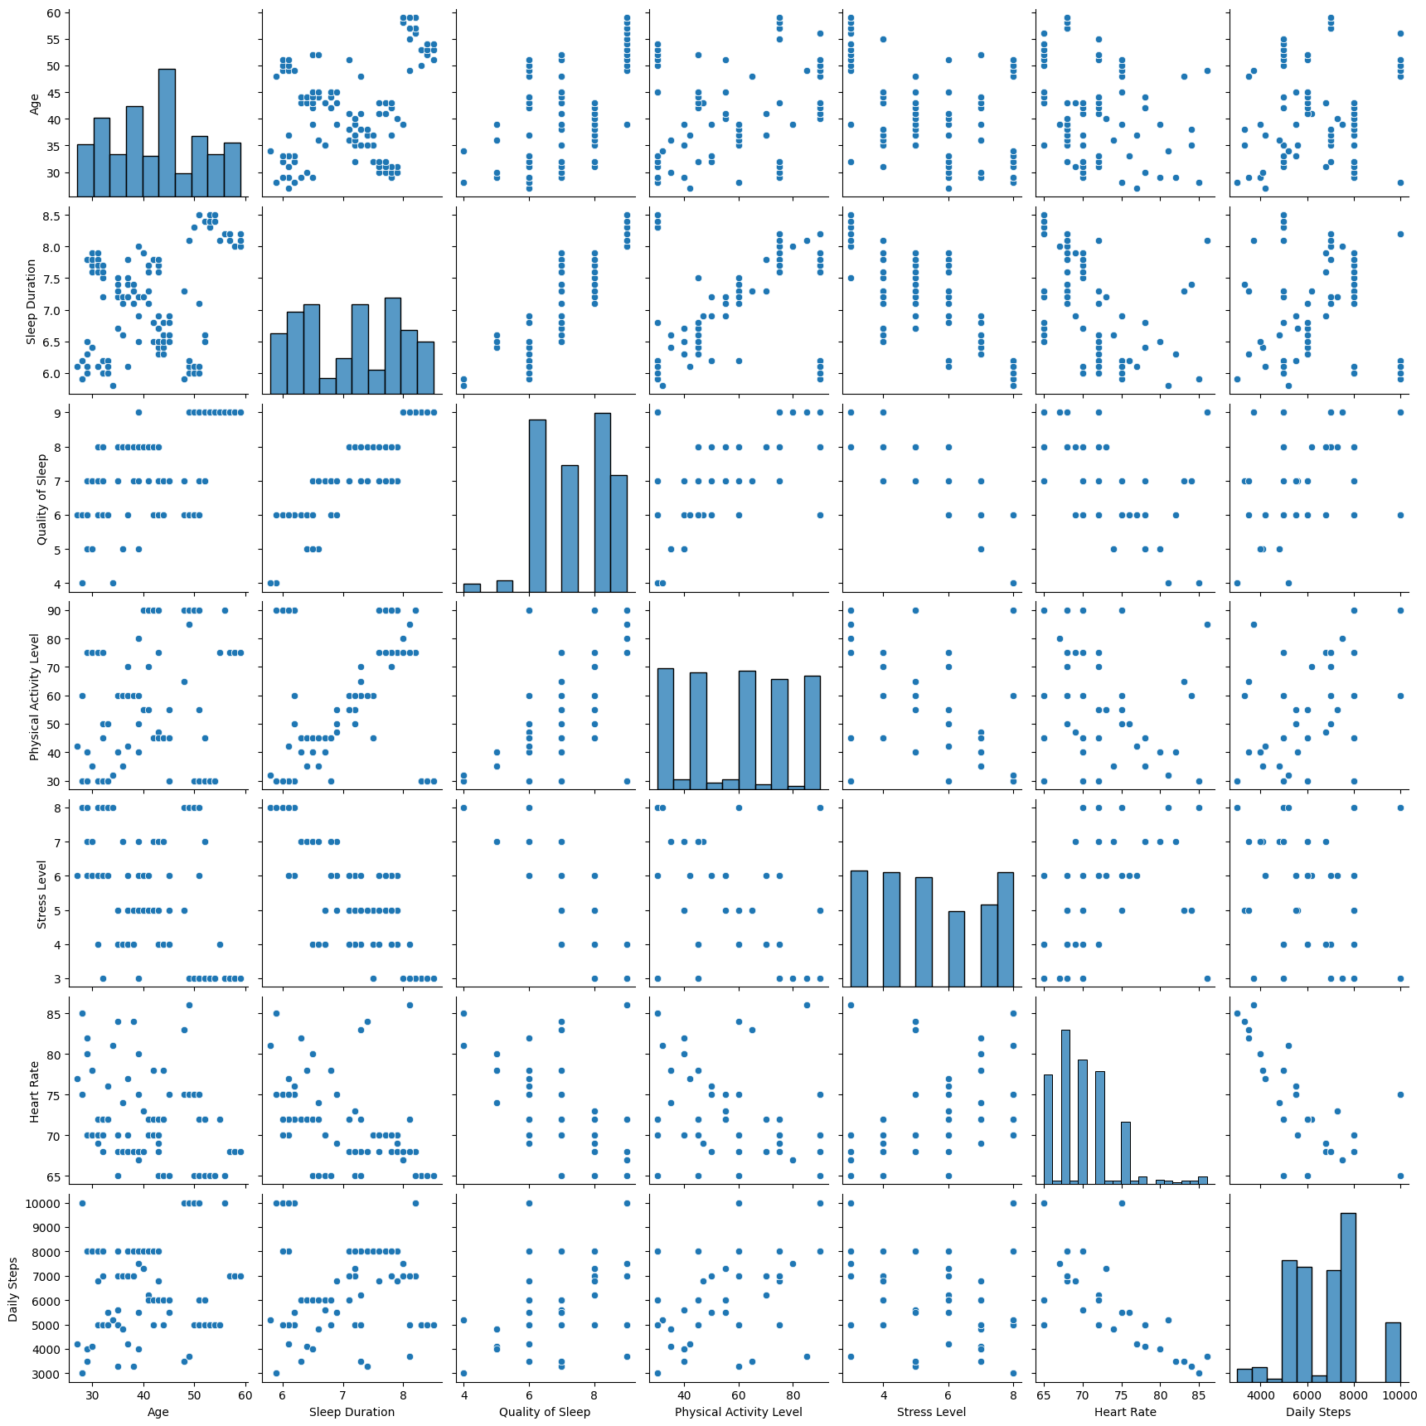
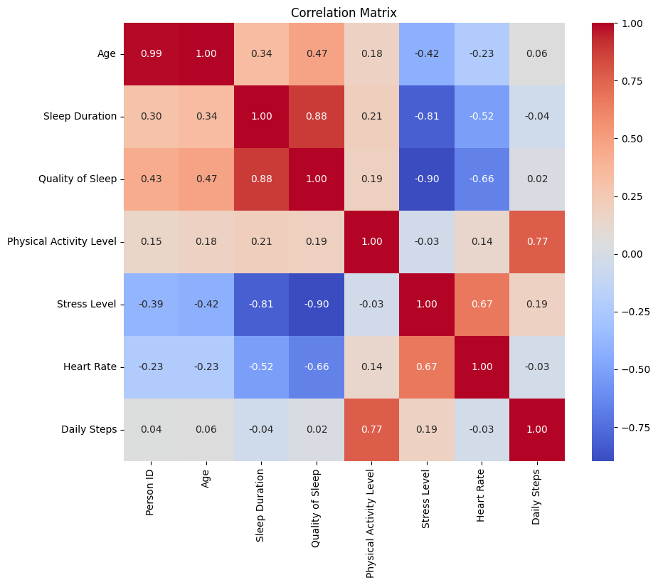
Method 1.
Finding the correlations
Notes:
We also made a visualisation of the heatmap.
as you can see, the tendency is clearly visible without any data processing.

Slide 12
Method 1.
Training the model
 | Training score (s.f.5) | Testing score (s.f.5)
 | 0.84281 | 0.74667
One Hot Encoding & Standardization
 | 0.98662 | 0.86667
MLP (Multilayer perceptron)
 | 0.98328 | 0.89333
Notes:
by linear regression, we picked the numeral values for the logistic regression and had a value of 0.84281 and 0.74667, shortened by the significant number of 5.
Then, with the unsatisfying value, we tried again including non numeral values using one hot encoding
changin in to MLP lowened the training score but
overfit

Slide 13

Method 2.
Exercise Recommendation Plan Dataset
Purpose: Finding the just exercise intensity for the one who are stressed
Progress:
EDA
Preprocessing
Modeling
Optimizing
Heatmap
Data dropping
One Hot Encode
Logistic
Regression
MLP
etc
Hyper parameter tuning
Notes:
The second dataset is the dataset of fitness exercises usingBFP&BMI dataset, for the purpose of “Finding the just exercise intensity for the ones who are stressed to effectively manage the stress”
The progress was held by the following

Slide 14
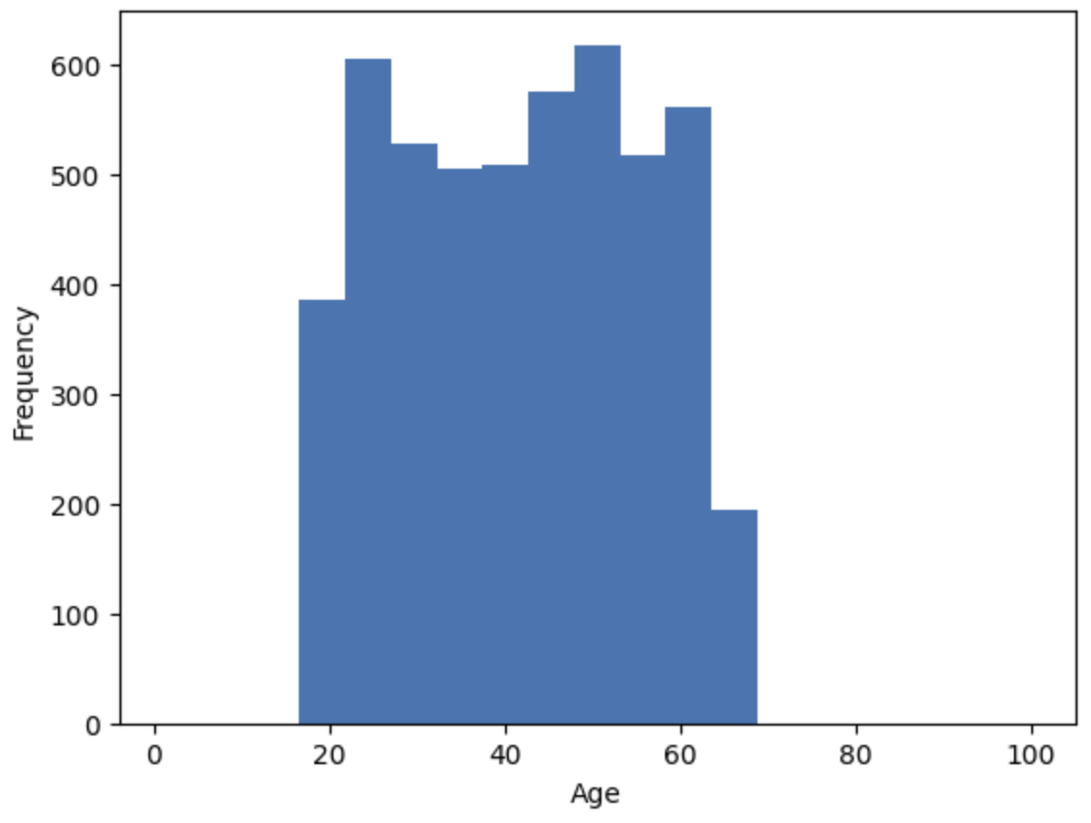
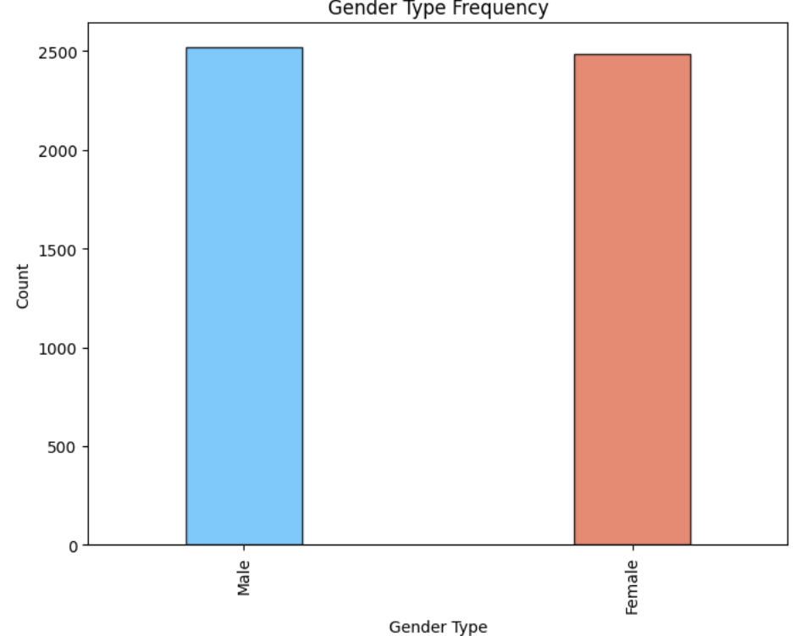
Method 2.
Checking the bias
Notes:
Firstly, We checked through visualization to see if the data has a bias.
As we can see, age is evenly distributed from 20s to 70s.
And Gender has the similar percentage.

Slide 15
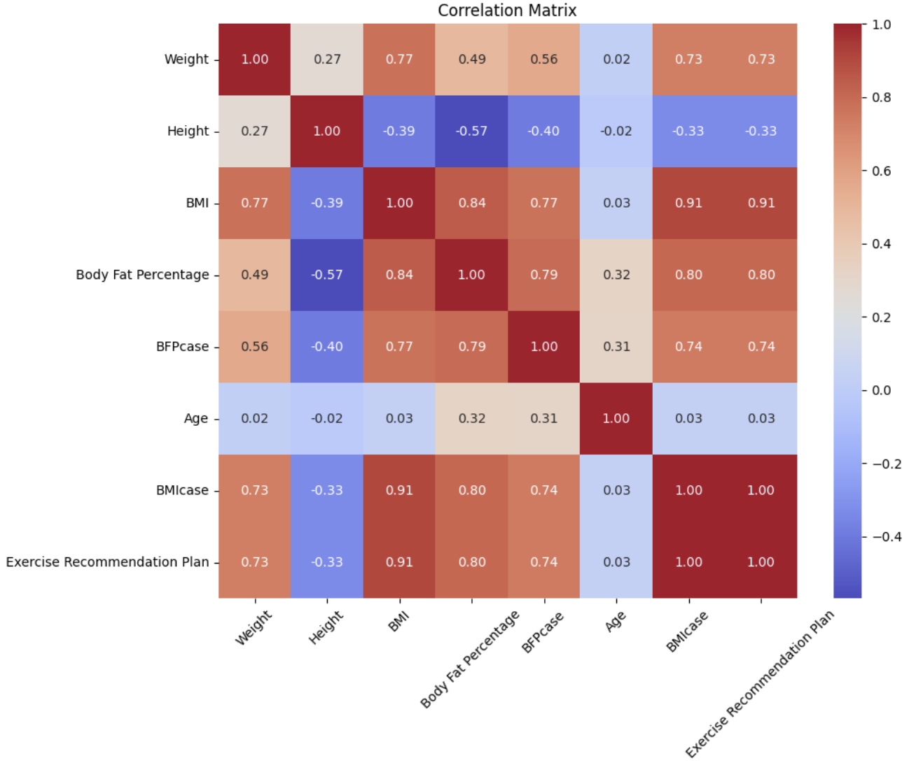
Method2
Finding the correlations
01
BMIcase
1.0
02
BMI
0.91
03
BFP
0.80
Notes:
BMI has a correlation of 1.0 with Exercise recommendation Plan. So, we had to remove the column.
We don't know exactly what a workout plan means.
However, this correlation allowed us to get information about Exercise recommendation Plan

Slide 16
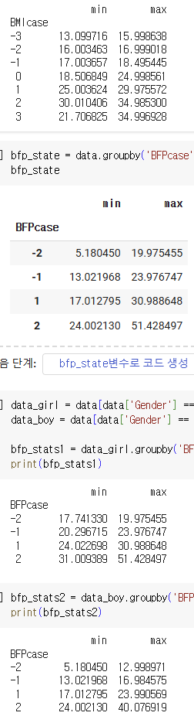
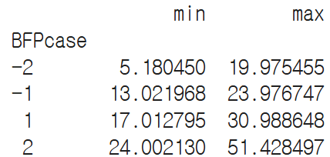
Method2
Finding Range
<BFPcase’s range>
'Athletes':-2, 'Fitness':-1, 'Acceptable':1, 'Obese':2
BMIcase’s range
'sever thinness': ~15.9, 'moderate thinness': 16~16.9, 'mild thinness': 16.9~17, 'normal':17~18.49, 'over weight': 18.5~24.9, 'obese': 25~29.9, 'severe obese':30~
Notes:
I took the user's height, weight, gender, and age and found out the range of BMIcase and BFPcase to tell them BMI and body fat percentage and BMIcase and BFPcase. BMIcase was divided smoothly, but

Slide 17
Method2
Finding Range
<BFPcase’s range>
'Athletes':-2, 'Fitness':-1, 'Acceptable':1, 'Obese':2
BMIcase’s range
'sever thinness': ~15.9, 'moderate thinness': 16~16.9, 'mild thinness': 16.9~17, 'normal':17~18.49, 'over weight': 18.5~24.9, 'obese': 25~29.9, 'severe obese':30~
Notes:
BFPcase was initially difficult because the range was not divided accurately and there were overlapping parts.

Slide 18
Method2
Finding Range
<BFPcase’s range>
'Athletes':-2, 'Fitness':-1, 'Acceptable':1, 'Obese':2
woman’s
BMIcase’s range
'sever thinness': ~15.9, 'moderate thinness': 16~16.9, 'mild thinness': 16.9~17, 'normal':17~18.49, 'over weight': 18.5~24.9, 'obese': 25~29.9, 'severe obese':30~
man’s
Notes:
So I searched for a body fat percentage calculator and found that it calculates body fat percentage differently depending on gender, so I divided the data into women and men and found out the range, and it came out accurately.

Slide 19
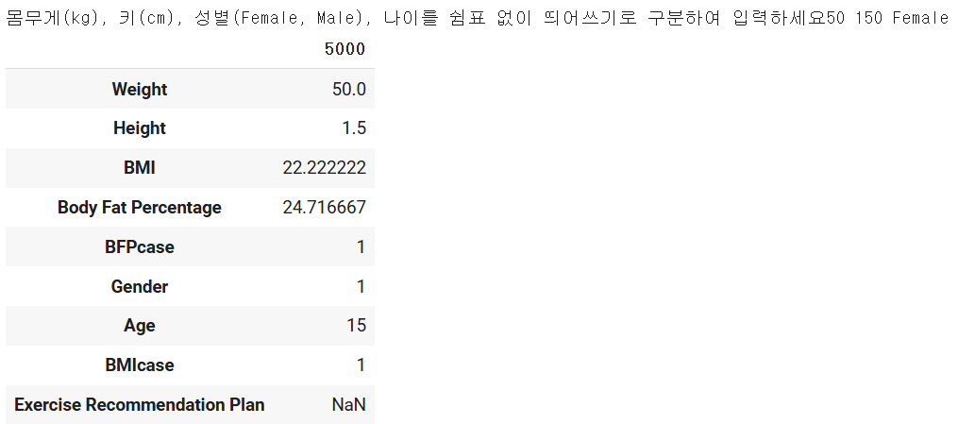
Method2
Using User_data
Q. Enter your weight (kg), height (cm), gender (Female, Male), and age separated by spaces without commas.
A. 50 150 Female 15
Notes:
Considering the range, I took the user's height, weight, gender, and age and found BMI and BMIcase, Body Fat Percentage and BFPcase, combined them with the original data, and outputted the data to find this.

Slide 20
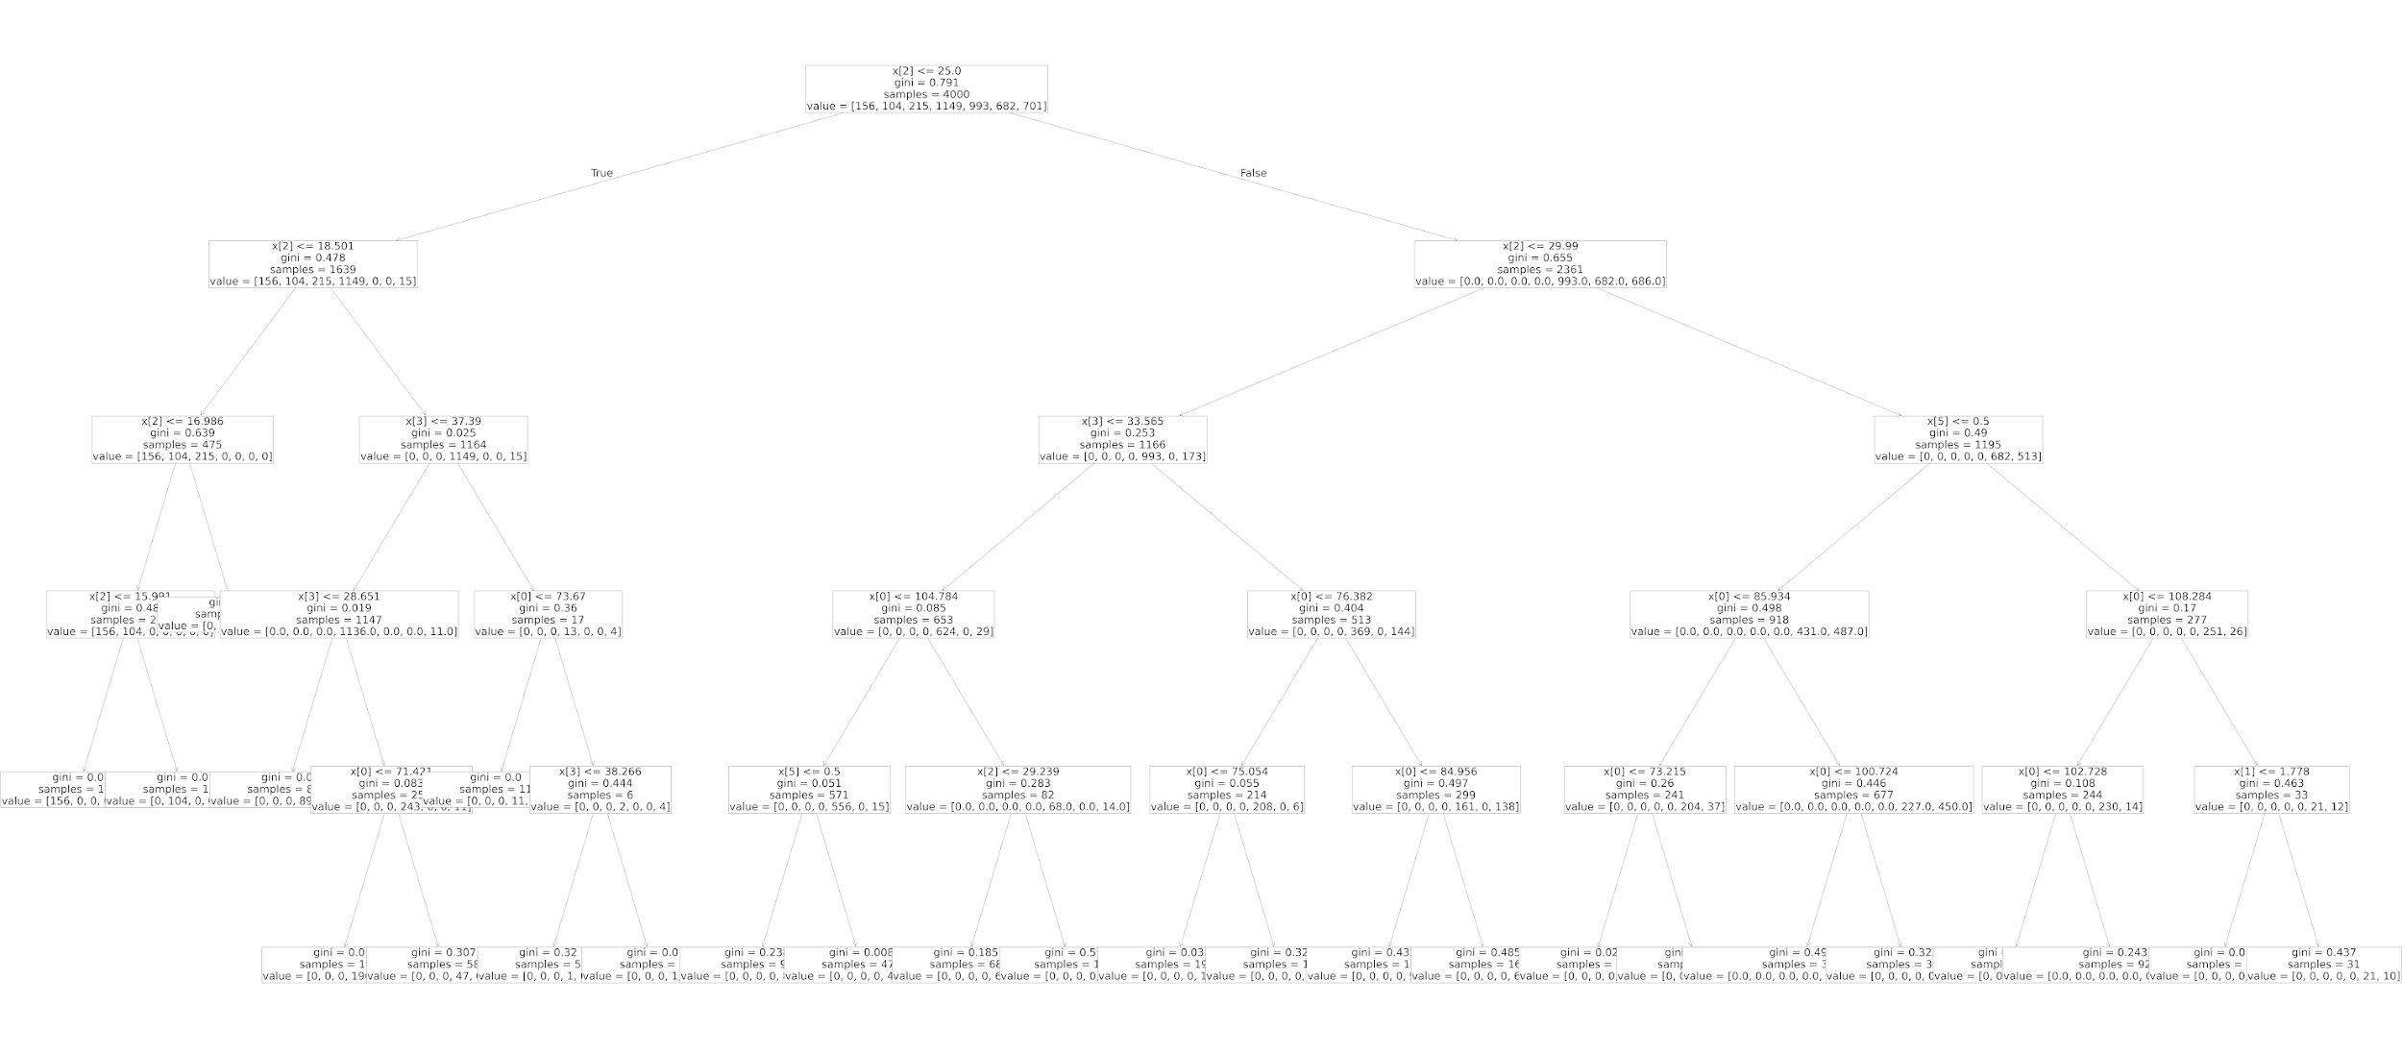
Method2
DecisionTree Classifier
Notes:
This is visualization of DecisionTreeClassifier. This selects the most important feature to split the data and recursively builds a tree structure.

Slide 21
Method2
DecisionTree Classifier
Notes:
New data is classified by following the conditions of the tree to reach a final leaf node.

Slide 22
Method 2.
Training the model
 | Training score | Testing score
DecisionTree Classifier | 0.88875 | 0.875
SVM | 0.87625 | 0.869
MLP Classifier | 0.84175 | 0.842
Linear Regression | 0.84178 | 0.850
Notes:
I tried to learn 4 models and find the optimal model.
In this process, overfitting was solved through normalization using Ridge and Lasso, and the optimal parameters were found and re-trained through hyperparameter tuning.
As a result, the following scores were obtained.
Overall, the scores look pretty good
As you can see, it was found that the decision tree was the most suitable.

Slide 23
Method2
Conclusion
Method 1.
Sleep Health and Lifestyle Dataset
Acknowledging the relation with stress and factors.
0.89
Method 2.
Exercise Recommendation Plan Dataset
With personal data, we can recommend the exercise plan with the relation
0.87
∴
With personal data, we can acknowledge if one have stress, and recommend the exercise plan to mitigate the stress to stay healthy
Notes:
Each model of prediction seems to be able to obtain meaningful results, meaning that it is at a high level. We tell the user whether he or she is stressed based on his or her data and whether we can encourage exercise to relieve stress.
Therefore, “”

Slide 24

Conc.
Conclusion
Method 1.
Sleep Health and Lifestyle Dataset
Acknowledging the relation with stress and factors.
Method 2.
Exercise Recommendation Plan Dataset
With personal data, we can recommend the exercise plan with the relation
▲Fig.1. QR code to our site to examine your own personal data
∴
With personal data, we can acknowledge if one have stress, and recommend the exercise plan to mitigate the stress to stay healthy
Notes:
The QR code allows you to do this. Go in there
We obtained weights and biases from our model through the results.coef_ and results.intercept_methods. We built this platform by obtaining equations from the model

Slide 25
Conclusion
Ethics Guidelines in terms of Machine Learning
Beneficence should not be considered only for specific people, such as the customers of the car, or customers who made a submission to the research.
Machine learning should observe non-maleficence in any aspects.
When there was a decision made by Artificial Intelligence or a program run by machine learning, the mechanism and the point of view why the result was made should be indicated to the people who are involved, by providing explicability.
Do not collect data illegally. And provide the source of the datas.
.
.
.
Notes:
Before the project, we made the ethics guidelines in terms of machine learning.
Do you know the trolly dilemma?
the ethical dilemmas have come into real-life problems due to the advance of technologies : so now decision of the dilemmas depends solely on engineers.

Slide 26

Conclusion
Ethics Guidelines in terms of Machine Learning
Beneficence should not be considered only for specific people, such as the customers of the car, or customers who made a submission to the research.
Machine learning should observe non-maleficence in any aspects.
When there was a decision made by Artificial Intelligence or a program run by machine learning, the mechanism and the point of view why the result was made should be indicated to the people who are involved, by providing explicability.
Do not collect data illegally. And provide the source of the datas.
.
.
.
▲Fig.2. QR code to the GitHub site showing our sources for the project
Notes:
We were aware of this problem, and adapted the guideline also to our project
With the qr code, you can see the github site, showing our source and codes from the project. It provides explicability, following to our third guideline.

Slide 27
Thank You
Finding stress factors and solving them through auto exercise recommendation
-Suwon Jang, Hyein Jo, Yewon Park-
Notes:
Thank you for listening our presentation.

